Slide 1


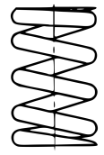
Railway Challenge – Technical Tips for New Teams
Always try to pivot chain-driven shafts co-axially with the driving shaft
If this cannot be achieved, use a chain tensioning system

Slide 2
Railway Challenge – Technical Tips for New Teams
Chain-driven shafts must remain parallel to the drive shaft and not move longitudinally

Slide 3
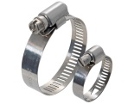

Railway Challenge – Technical Tips for New Teams
Locomotives are a harsh vibration environment - don’t rely on push connectors
This equally applies to electrical connections – use bayonet or screw fittings

Slide 4
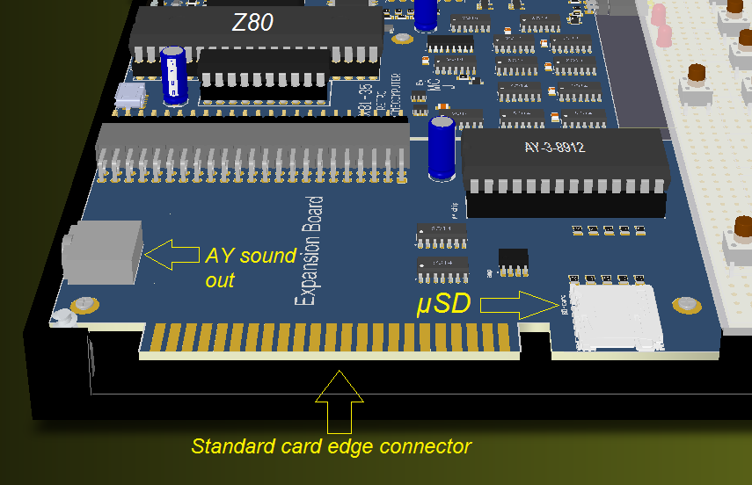
Railway Challenge – Technical Tips for New Teams
Don’t rely on edge connectors – locomotive vibration levels will shake PCBs out
Use secondary fixings for all circuit board and other control system interconnects

Slide 5
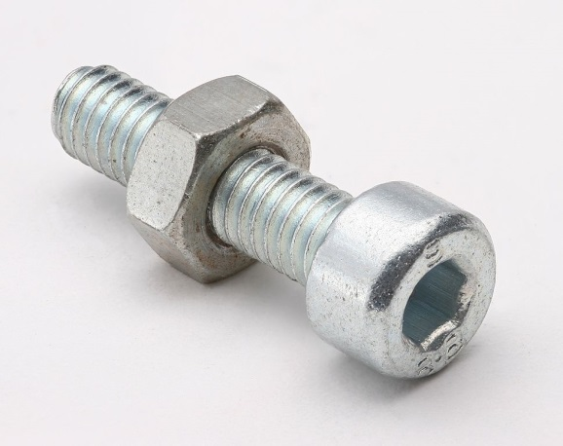

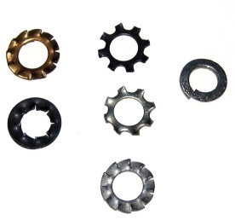
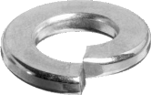
Railway Challenge – Technical Tips for New Teams
Locomotives, and bogies in particular, are subject to continuous impact loads
Lock all screwed fittings

Slide 6

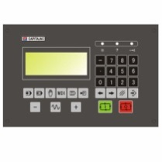
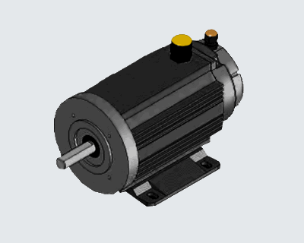
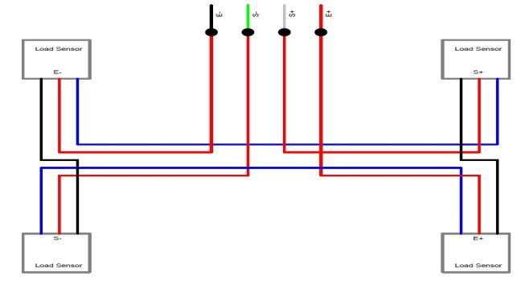
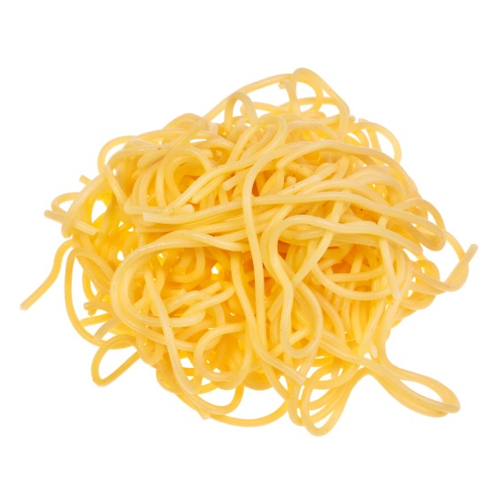
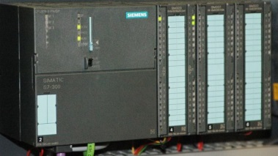
Railway Challenge – Technical Tips for New Teams
Keep the design modular and wiring laid out logically to facilitate fault finding
Design and group all wiring runs carefully. No individual point to point connections

Slide 7
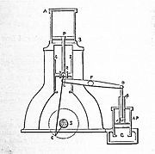
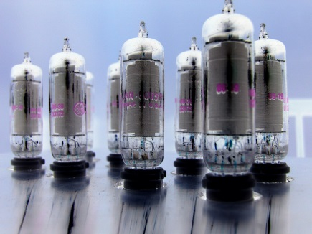
Railway Challenge – Technical Tips for New Teams
Think about EMC
P.T.O.

Slide 8
Railway Challenge – Technical Tips for New Teams
Make electronics resistant to EMI by employing best practice, such as:
· Employing isolated power supplies (e.g. isolated DC/DC converters) to power the control electronics.
· Electrically isolating all control inputs/outputs (e.g. using opto-isolators).
· Keeping control wiring neat and routed away from electrical noise sources.
· Using twisted pairs and/or screened cables for signal wires, if necessary.
· Having a common chassis earth connection to prevent ground loops.
· Avoiding circulating screen currents in the control electronics (common connection point for screen connections).
· Better to use screened metal enclosures rather than plastic

Slide 9
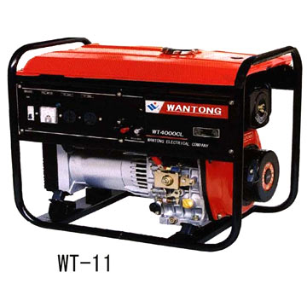
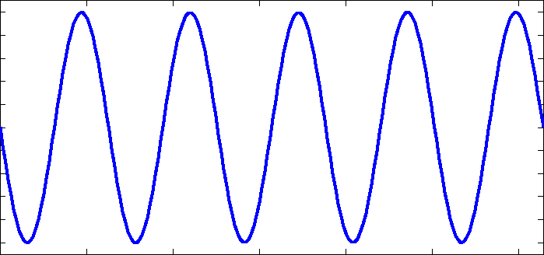
Railway Challenge – Technical Tips for New Teams
Generators rarely put out anything like a clean sine wave
Make sure your control systems are designed and tested accordingly

Slide 10
Railway Challenge – Technical Tips for New Teams
Traction motors do not draw the current profile of ideal scenario calculations
Make sure your traction components are significantly over-rated and protected accordingly

